Slide 1
Multi-hop Relaying with Optimal Decode-and-Forward Transmission Rate and Self-Immunity to Mutual Interference among Wireless Nodes
Xiaohua Li and Jeong Kyun Lee
Department of Electrical and Computer Engineering
State University of New York at Binghamton
{xli,jlee54}@binghamton.edu

Slide 2
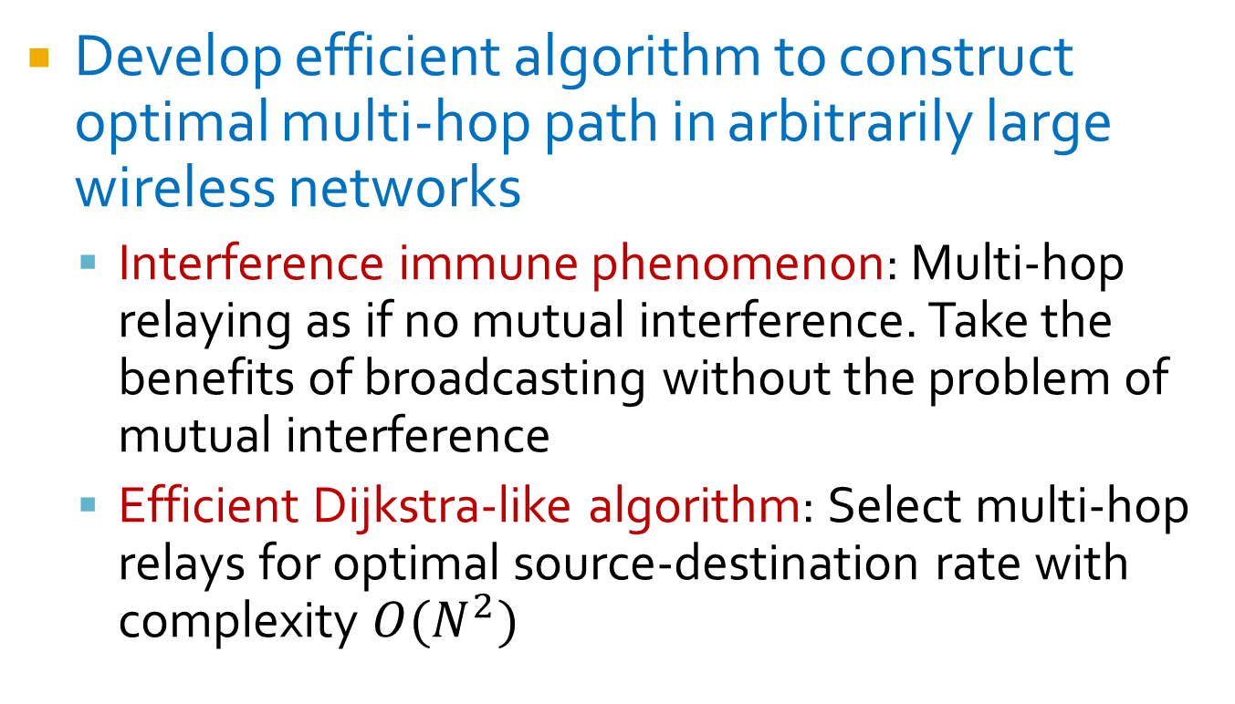
Major contributions
Develop efficient algorithm to construct optimal multi-hop path in arbitrarily large wireless networks
  Interference immune phenomenon: Multi-hop relaying as if no mutual interference. Take the benefits of broadcasting without the problem of mutual interference
  Efficient Dijkstra-like algorithm: Select multi-hop relays for optimal source-destination rate with complexity $O(N^{2})$

Slide 3
1. Introduction
Multi-hop networking problem:
  Find optimal hop count, select optimal relays, determine optimal source-destination rate
  Wired networks:
    Dijkstra’s algorithm (shortest path, widest path)
  Wireless networks: an open challenge
    Challenge of mutual interference, broadcasting

Slide 4
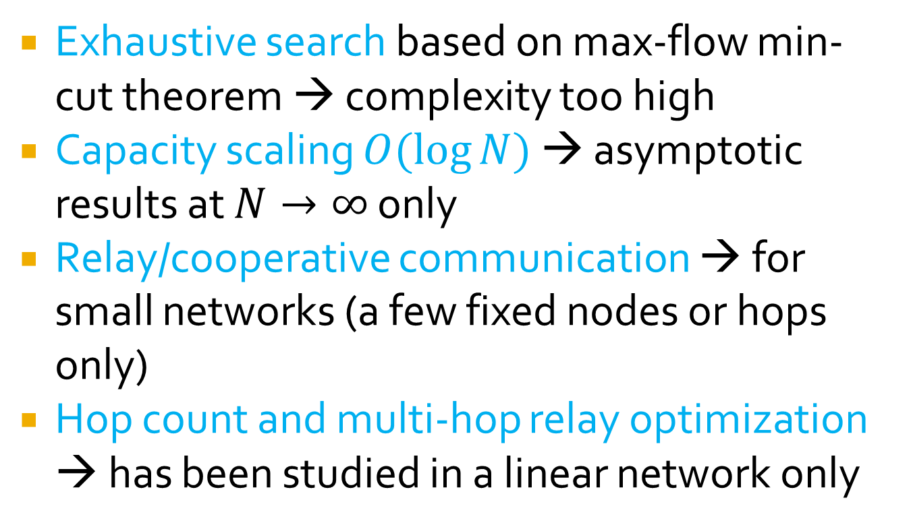
Existing work for this wireless information flow problem
Exhaustive search based on max-flow min-cut theorem → complexity too high
Capacity scaling $O(\log{N})$ → asymptotic results at $N→∞$ only
Relay/cooperative communication → for small networks (a few fixed nodes or hops only)
Hop count and multi-hop relay optimization → has been studied in a linear network only

Slide 5
Objective: Algorithmic Approach
Algorithmic approach for this problem
  Develop new multi-hop relay selection algorithm to construct optimal multi-hop path
  Efficient for wireless networks with arbitrary size
  Optimal in terms of decode-and-forward rate
Based on an interesting phenomenon of wireless networks: interference immunity
  A large class of multi-hop wireless operations can be conducted as if there is no mutual interference

Slide 6

2. System model
Wireless network with $N+2$ random nodes
  Source node $0$, destination node $N+1$, and $N$ relay candidate nodes
  Need to select relays to construct rate-optimal multi-hop path from source to destination

Slide 7
Relaying strategy
Assume causal full-duplex (FD) decode-and-forward (DF) relays
  A relay can transmit simultaneously a packet while receiving another packet
  DF is popular in practical or large multi-hop wireless networks
  FD is optimal theoretically, promising practically
  Causality: relay can transmit packets received/decoded during past slots only

Slide 8
Slotted multi-hop packet forward scheme
One packet per slot: A packet reaches the destination node in each slot

Slide 9

Signal model
Relay $r_{j}$ receives all other relays’ broadcasted signals
    Signals transmitted by relays in its preceding hops
    Signals transmitted by itself
    Signals transmitted by relays in its subsequent hops

Slide 10
Assumptions on signal model
Each relay has a power limit:
  Need to optimize relaying power
Each relay has AWGN with power
Instantaneous flat fading channel:
Transmitted signal has unit power:
Channels coefficients and re-encoding rules are public knowledge

Slide 11
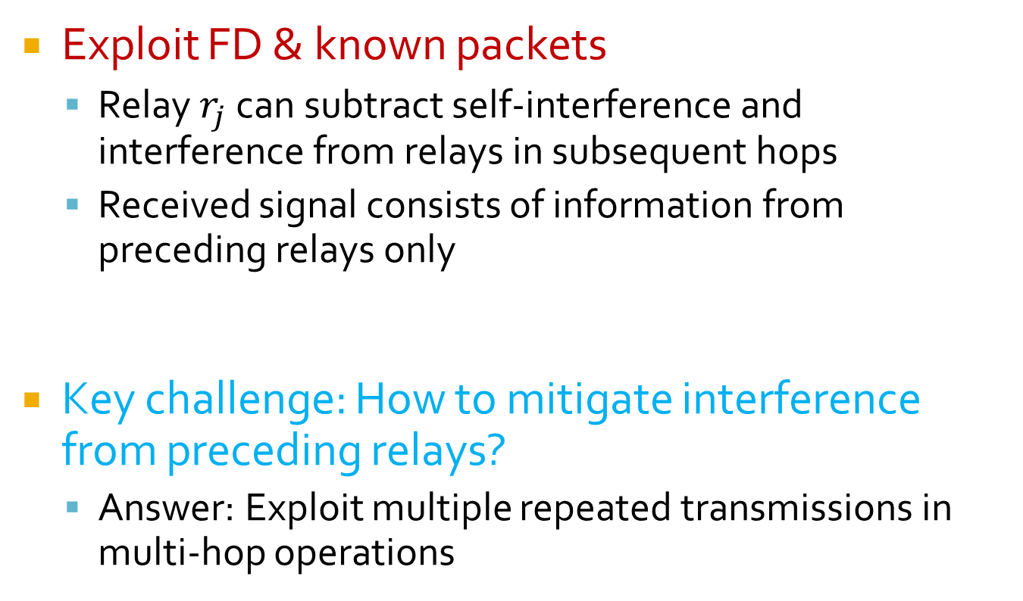
3. Interference immune phenomenon
Exploit FD & known packets
  Relay $r_{j}$ can subtract self-interference and interference from relays in subsequent hops
  Received signal consists of information from preceding relays only
Key challenge: How to mitigate interference from preceding relays?
  Answer: Exploit multiple repeated transmissions in multi-hop operations

Slide 12

Exploit multiple repeated transmission of the same packet
Each packet is transmitted once by each relay
Full knowledge of relay $r_{j}$ on a packet: $j$signals received in past $j$ slots

Slide 13
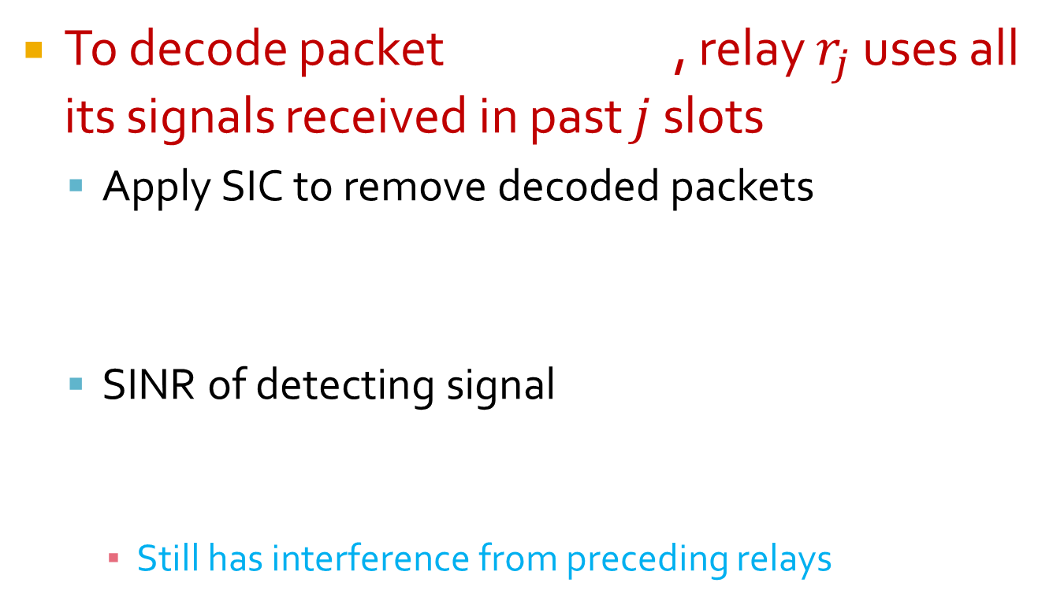
Successive interference cancellation
To decode packet , relay $r_{j}$ uses all its signals received in past $j$ slots
  Apply SIC to remove decoded packets
  SINR of detecting signal
    Still has interference from preceding relays

Slide 14
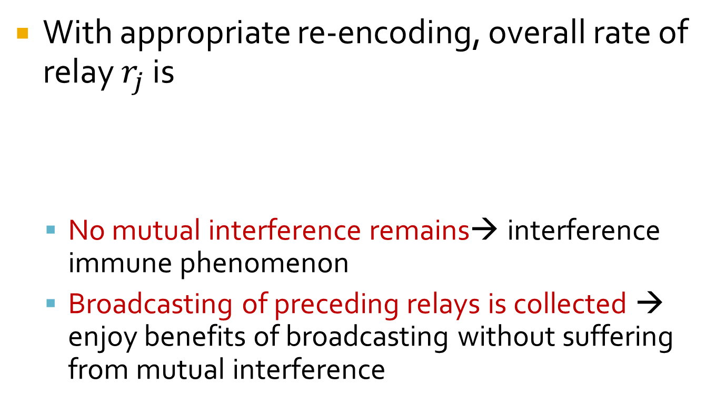
Achieve immunity to mutual interference
With appropriate re-encoding, overall rate of relay $r_{j}$ is
  No mutual interference remains→ interference immune phenomenon
  Broadcasting of preceding relays is collected → enjoy benefits of broadcasting without suffering from mutual interference

Slide 15
4. Algorithmic approach for optimal multi-hop path construction
Define source-destination rate
Formulate optimal multi-hop path construction
  Find optimal hop count, relay node selection and relay power optimization for rate maximization
Like a water pipe, rate is limited by the minimum tunnel

Slide 16
Unique properties due to interference immunity
Relays just use full relaying power
A relay always increases rates of its subsequent relays
A relay is not affected by its subsequent relays
Greedy algorithm: It is optimal to adopt greedily all relays with highest rate

Slide 17
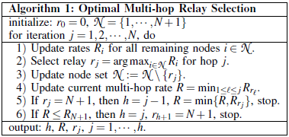
Dijkstra-like Algorithm

Slide 18
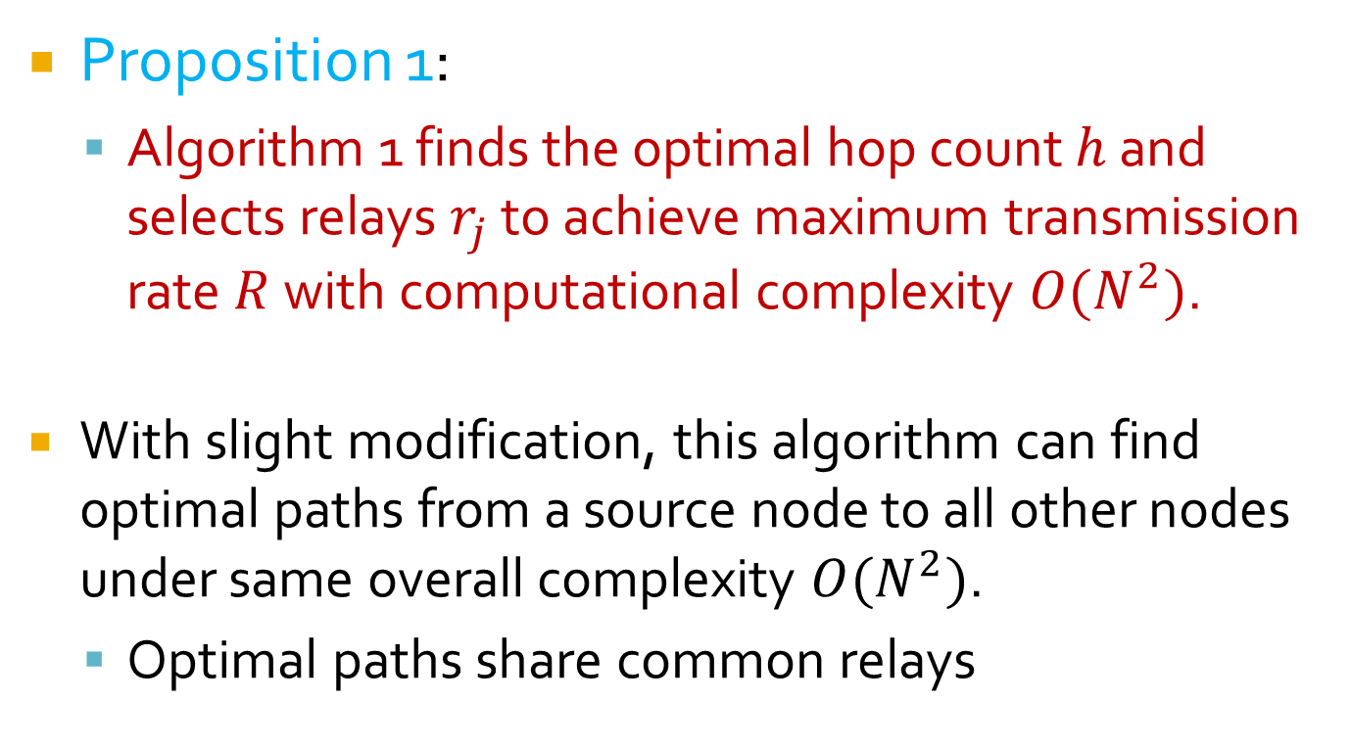
Optimality and efficiency
Proposition 1:
  Algorithm 1 finds the optimal hop count $h$ and selects relays $r_{j}$ to achieve maximum transmission rate $R$ with computational complexity $O(N^{2})$.
  With slight modification, this algorithm can find optimal paths from a source node to all other nodes under same overall complexity $O(N^{2})$.
  Optimal paths share common relays

Slide 19
Decode-and-forward rate
Proposition 2: For 3-node relay network, algorithm 1 gives the optimal DF rate
Proposition 3: Single relay in each hop is optimal for DF relaying strategy

Slide 20
5. Simulations: Random network
Verified: optimality, efficiency, capacity scaling $O\left(\log{N}\right)$.

Slide 21
A regular grid network: in fixed area or with fixed node density
Compare optimal DF rate with practically achieved rates.

Slide 22
6. Conclusions
Interference immune phenomenon:
  SIC+Encoding makes full-duplex decode-and-forward relays interference-free
Multi-hop path construction for optimal DF rate
  Exploit multi-hop broadcasting without suffering from mutual interference
Dijkstra-like algorithm for wireless networks
  Find optimal hop count, optimal relays, to maximize DF rate
  Efficient for arbitrarily large wireless networks

