Slide 1

Performance Analysis of Coexisting Secondary Users in Heterogeneous Cognitive Radio Network
Xiaohua Li
Dept. of Electrical & Computer Engineering
State University of New York at Binghamton
Binghamton, NY 13902, USA
Email: xli@binghamton.edu

Slide 2
Major Contributions:
Develop a framework to analyze the throughput performance of heterogeneous cognitive radio networks (CRN)
  Develop Markov Model Bank (MMB) to model heterogeneous CRN and to derive its throughput
    Advantage: Feasible to analyze mutual interference among all users in large heterogeneous CRN
  Formulate sum-of-ratios linear fractional programming (SoR-LFP) to derive theoretically optimal CRN throughput
    Work as a benchmark for evaluating the optimality of practical CRN

Slide 3
Outline
Introduction
System model
MMB for hetero-CRN and throughput analysis
SoR-LFP for CRN throughput optimization
Simulations
Conclusions

Slide 4
1. Introduction
CRN reuses spectrum white spaces
  CRN sense spectrum for spectrum white spaces, access the spectrum white spaces secondarily, and vacate the spectrum when primary users come back
Heterogeneous CRN
  Choose spectrum sensing/access strategies freely
  Choose transmission parameters and spectrums freely
  Flexible software implementation

Slide 5
How do different CRN users coexist with each other?
  Need to analyze the performance of CRN under heterogeneous setting
CRN performance analysis is challenging
  Mostly done by simulation rather than analysis
  Limited analysis results are for simplified &homogeneous CRN, or for small CRN with a few users only
  Optimal performance is unknown: a long-standing challenge

Slide 6
We focus on CRN throughput analysis
  Throughput: product of time spent in successful data transmission and capacity of the channel used in this transmission
    Each CRN user’s throughput, overall CRN throughput
    Need to consider CRN operation modes, and mutual interference among all the CRN users
  Throughput optimization: assign transmission power optimally to available channels for maximum throughput

Slide 7
Objectives:
  Develop a way to analyze CRN throughput under practical strategies and mutual interference
  Look for theoretically optimal CRN throughput
Challenges:
  large CRN with many different mutually interfering users
  How to take the unique CRN characteristics into modeling and analysis?
  How to derive optimized/ideal throughput?
Notes:
In the sense of cooperative transmission.
Delay or frequency offset will destory the STBC encode, in the case of OFDM the major bundle become the ICI cause by frequency offset.

Slide 8

2. System Model
Consider CRN with $I$secondary users (SU) and $K$ channels
  Channel available probability $θ_{k}$, SU offered load $α_{i}$

Slide 9
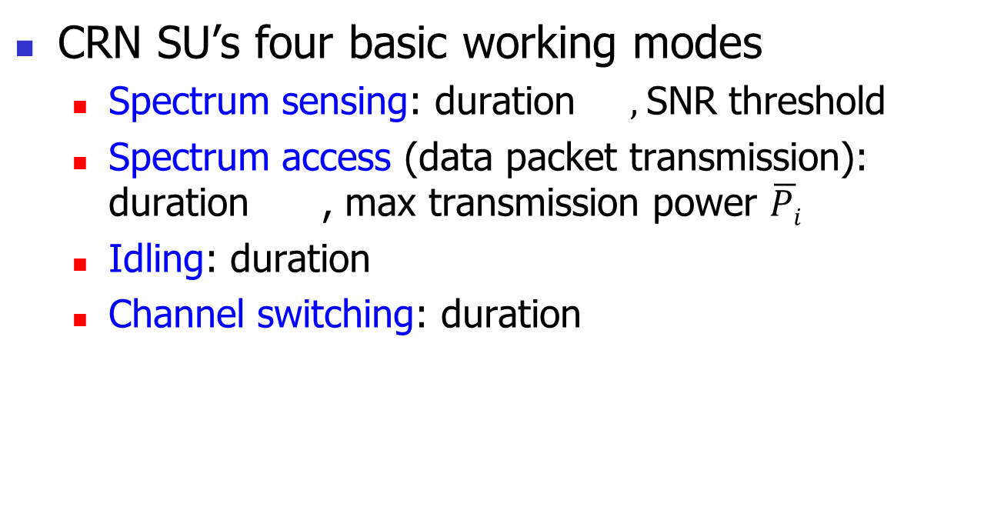
CRN SU’s four basic working modes
  Spectrum sensing: duration $,$SNR threshold
  Spectrum access (data packet transmission): duration , max transmission power $\overline{Pi}$
  Idling: duration
  Channel switching: duration

Slide 10
SU’s transmission power in each channel
  Practical: Use max power, one channel each time
  Theoretical: distribute power among all channels
Basic equations for SU
  Signal, SNR, sum throughput

Slide 11

3. CRN Model and
Throughput Analysis
Markov model bank (MMB)
  A separate Markov chain for each user
  $3K+1$ states in each separated Markov chain
  Users & Markov chains connected implicitly by transitional probability

Slide 12
Essential idea of MMB
  Reduce complexity of Markov chains, put all complexity into a transitional probability → good for feasible & efficient analysis of mutual interference
Steady-state probability

Slide 13
Transitional probability evaluation
  Mutually-coupled transitional probabilities can be calculated by root-finding algorithms

Slide 14
CRN throughput
  Each user throughput:
  Overall throughput:

Slide 15
4. CRN Throughput Optimization
Assume fully cooperated users to jointly optimize their transmission powers in all channels
  Objective function: max sum throughput of all users
  Used as a benchmark for evaluation of CRN throughput performance

Slide 16
Formulation of the optimization problem
  where

Slide 17
Reformulate into Sum-of-Ratios Linear Fractional Programming (SoR-LFP)
  where
  Some existing algorithms can be modified to solve this optimization

Slide 18
Sum-of-ratios linear fractional programming
  A global optimization problem that has many applications and has stimulated decades of research
  Generally non-convex. But under some constraints, many successful algorithms have been developed to solve it
  Some such algorithm can be revised to solve our throughput-formulated problem

Slide 19
5. Simulations
Random Network,
Path-loss model,
Random PU act.,
SU load 0.9
Gap between CRN achieved throughput and the optimal CRN throughput. Analysis results are accurate.

Slide 20
Random Network,
Path-loss model,
Random PU act.,
Random SU load
CRN throughput increases with number of channels and number of SU. Analysis expressions are accurate & efficient for large heterogeneous CRN.

Slide 21
6. Conclusions
Developed a framework to evaluate the throughput performance of CRN
  Develop Markov Model Bank (MMB) to model CRN operations and analyze CRN throughput
    Accurate & efficient expressions for large heterogeneous CRN
  Formulate Sum-of-Ratios Linear Fractional Programming (SoR-LFP) to find the optimal CRN throughput
    Optimize non-convex expressions of sum of capacities

